Slide 1
AI Resume Analysis and Recruitment System
GUIDED BY,
Mrs. M. Thanga Aruna
Assistant Professor , ME, (PhD)
Saila Vishnu G (24BCS058)
Sakthi Yokesh S (24BCS059)

Slide 2
Introduction
AI Resume Analysis and Recruitment System—a cloud platform that reimagines talent matching.
The tech stack combines Sentence Transformers for semantic understanding, spaCy for intelligent resume parsing, and Gemini API for contextual feedback. ChromaDB powers vector search, letting recruiters find candidates with natural language queries. ATS scoring analyzes formatting, keywords, and structure—not just keyword counting.
Mock interviews use Retrieval-Augmented Generation to create personalized scenarios pulling role-relevant questions and candidate context for real-time evaluation.
Two portals: students get coaching; recruiters get smarter screening and analytics.

Slide 3
Problem Statement
Recruiters spend excessive time on manual screening. Evaluating hundreds of resumes manually consumes resources without scaling. Good candidates often get overlooked in the process.
Students lack structured guidance. No resume templates, minimal feedback on application quality, and no opportunity for interview practice. They navigate the job search without direction.
Resume quality goes unmeasured. Students submit weak applications without knowing it. No system evaluates resume strength, identifies skill gaps, or provides concrete improvement suggestions before they apply.

Slide 4
Objectives
To develop a resume analysis tool that provides detailed feedback and actionable improvement suggestions.
To develop mock interview practice with performance tracking and real-time evaluation.
To develop automated resume screening with intelligent AI-powered candidate ranking.
To develop faster hiring cycles through semantic matching and improved candidate-job fit.

Slide 5
Expected Outcomes
Students will identify resume weaknesses and improve application quality before submission.
Students will gain confidence and interview readiness through structured mock interview practice.
Recruiters will reduce manual screening time and focus on high-quality candidates.
Hiring teams will complete screening-to-shortlist cycles faster with better candidate matches.

Slide 6
Dataset Details
Models (No Custom Training):
Sentence Transformers – Pre-trained on semantic similarity tasks.
spaCy NLP – Pre-trained English language models.
Gemini API & Grok API – Pre-built, maintained by providers.
User-Generated Data (During Operation):
Student resumes (PDF/DOCX format).
Job descriptions from recruiters.
Mock interview responses and performance data.
User feedback for continuous improvement.

Slide 7
Working Environment
IDE:
• VS Code – Frontend, backend, and AI/ML development.
Version Control:
• Git & GitHub – Code management and collaboration.
Local Development:
• Node.js & npm – Frontend and backend dependencies.
• Python virtual environment – AI/ML services.
• MongoDB Atlas – Database testing and development.
Cloud Services:
• Cloudinary – Image and file storage.
• Postman – API testing and documentation.
Deployment:
• Vercel – Frontend deployment.
• Render – Backend and API deployment.

Slide 8
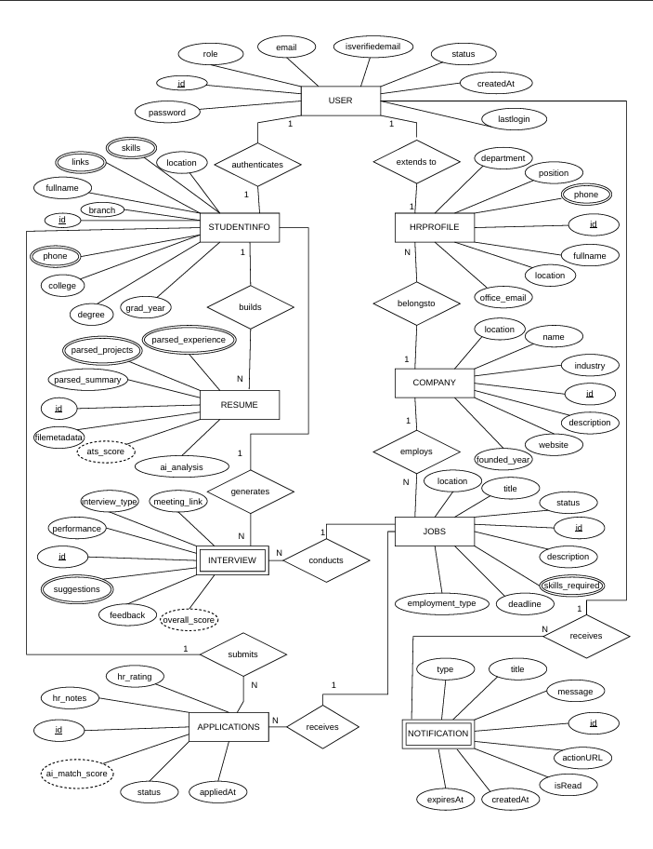
ER Diagram
Hyperlink : ER Diagram

Slide 9
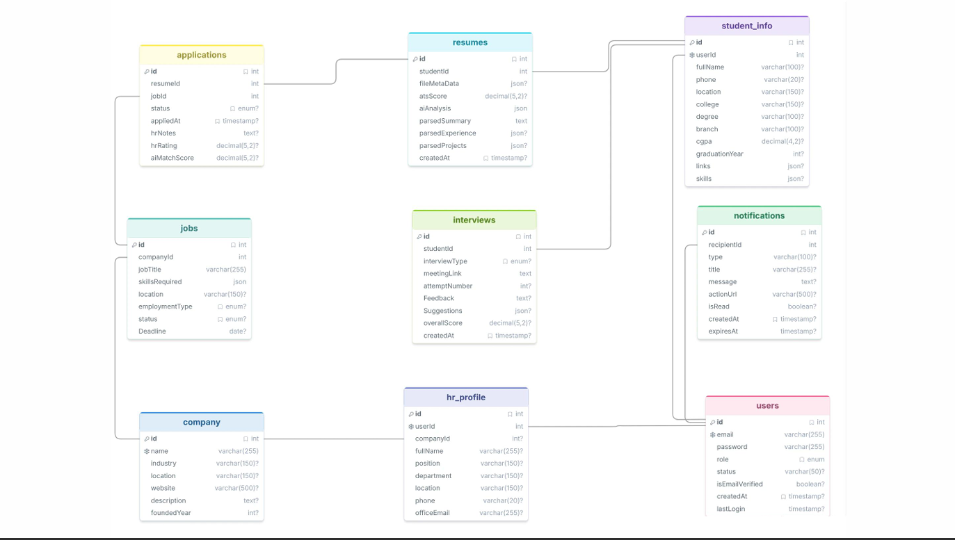
Database Schema Diagram
Hyperlink : Schema Diagram

Slide 10
Module Descriptions
UI Module – React UI for both student and recruiter portals. Node.js/Express API, authentication, and request routing.
AI/ML Module – Python FastAPI,
Sentence Transformers, spaCy NLP, Gemini / Grok API, semantic matching, resume parsing.
Cloud Services Module – Cloud storage for file/image, Vercel for frontend hosting, Render for backend deployment and Mongo DB for database.

Slide 11
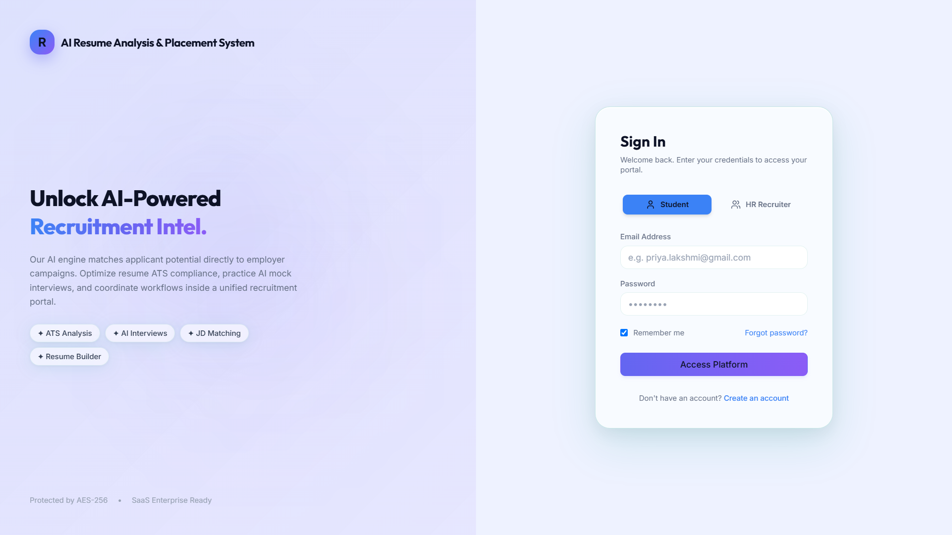
UI Screenshots
Fig 1.1: Login Page

Slide 12
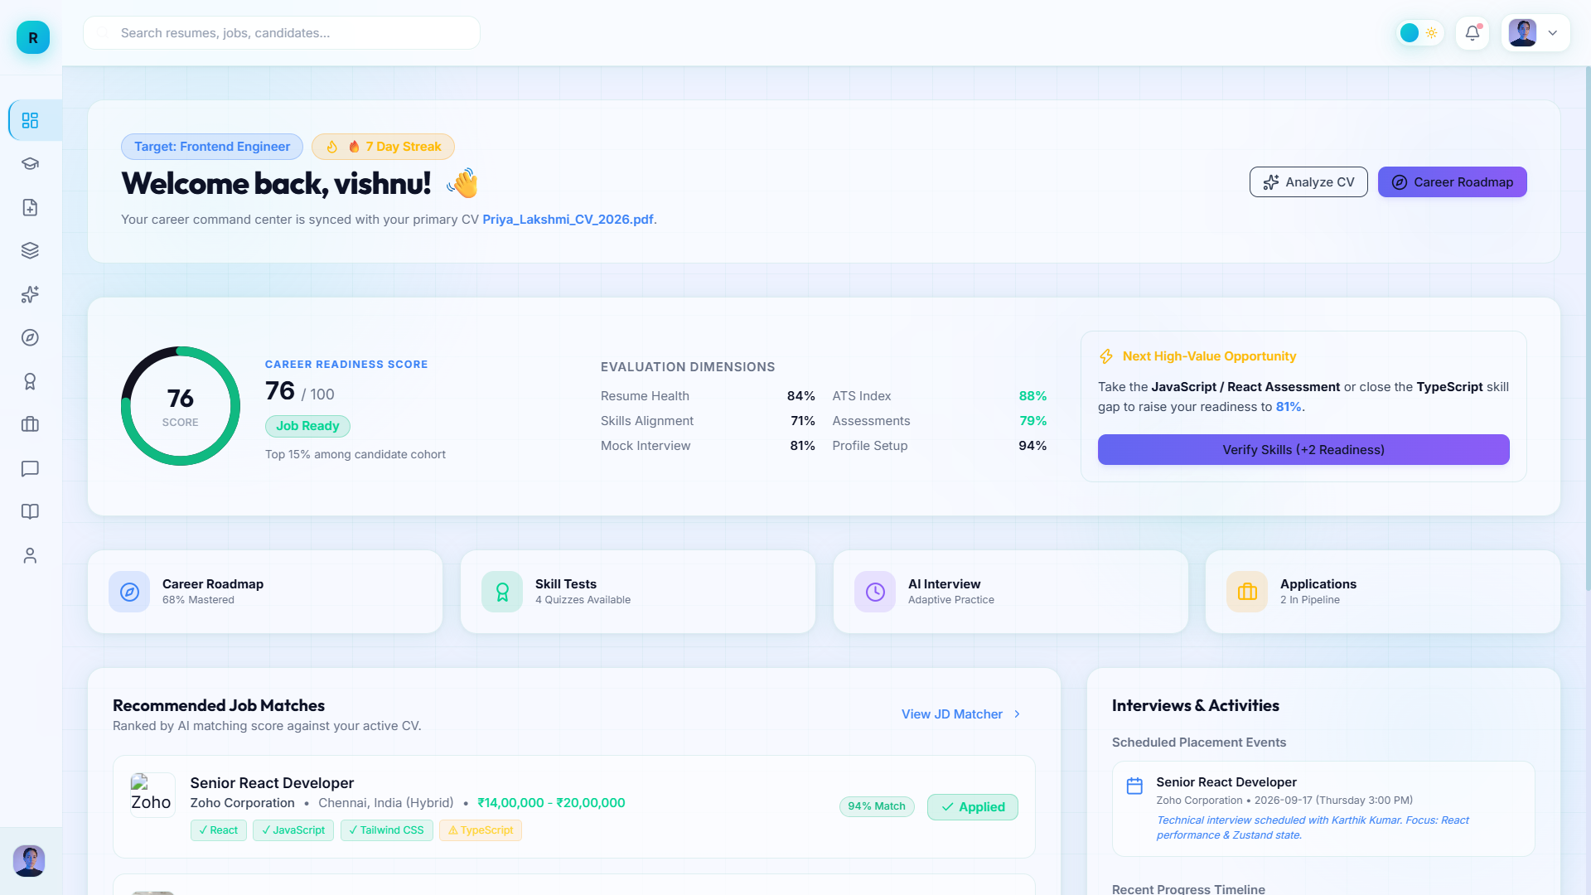
Fig 1.2: Dashboard Page

Slide 13
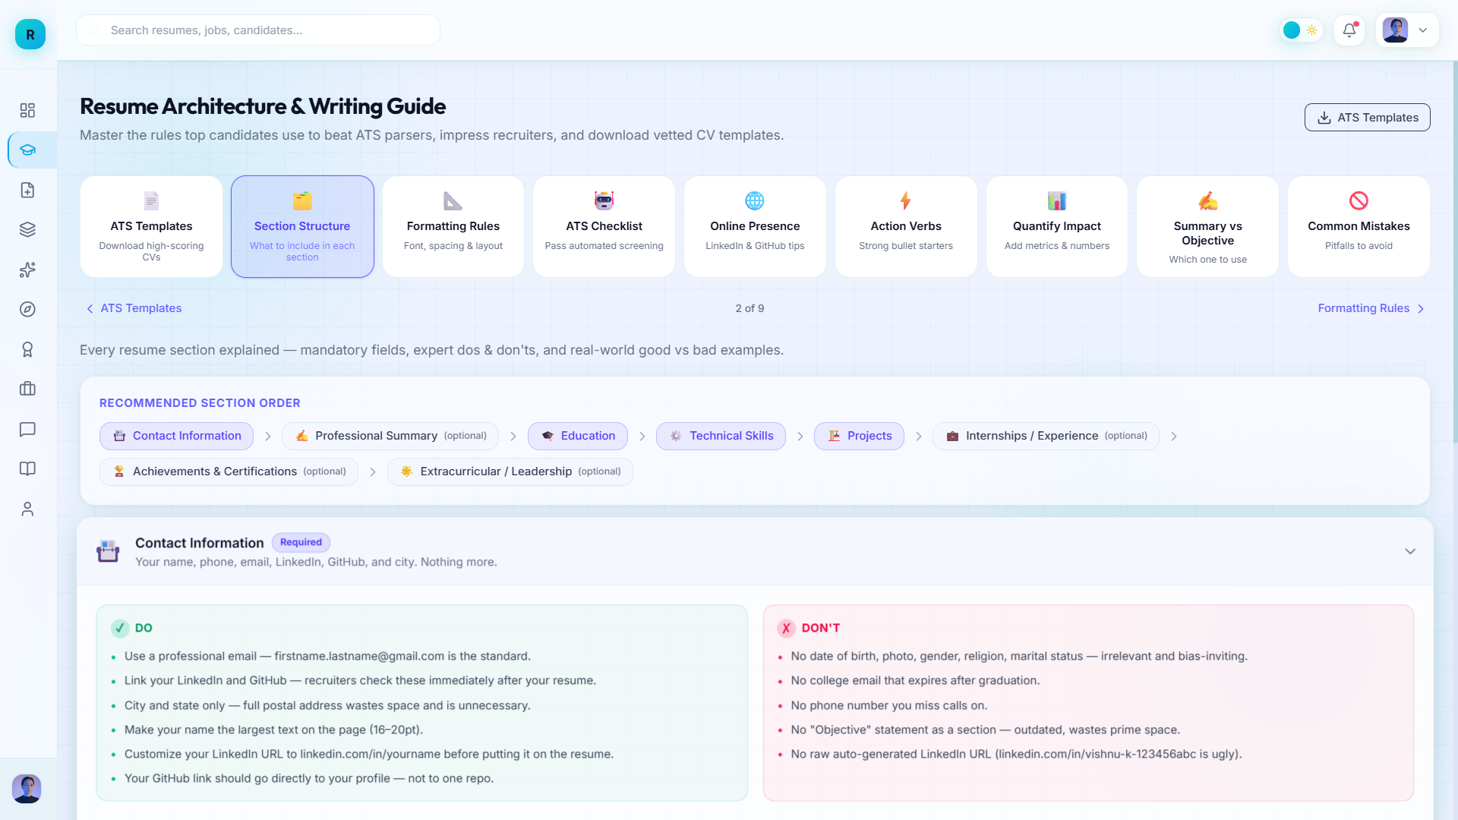
Fig 1.3: Resume Guide Page

Slide 14
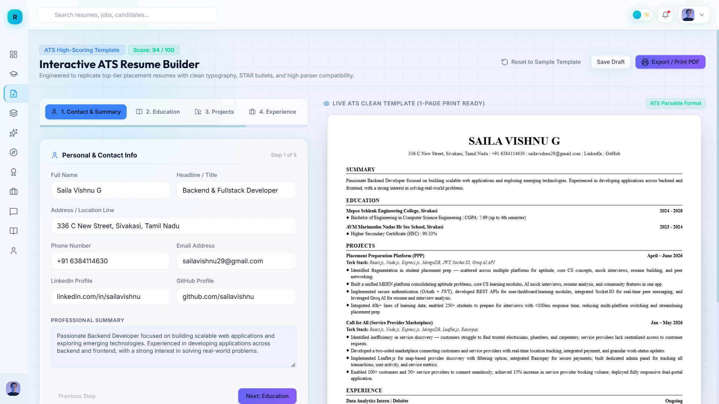
Fig 1.4: Resume Builder Page

Slide 15
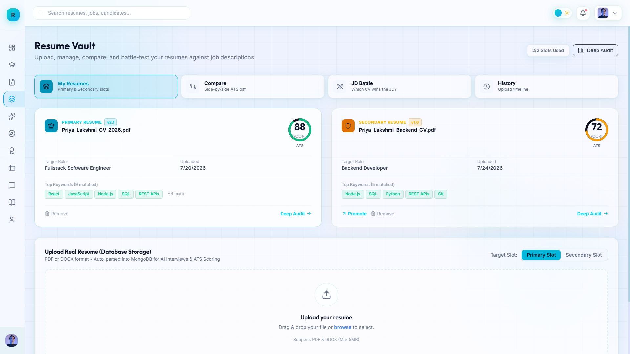
Fig 1.5: Resume Vault (Primary and Secondry Resume)

Slide 16
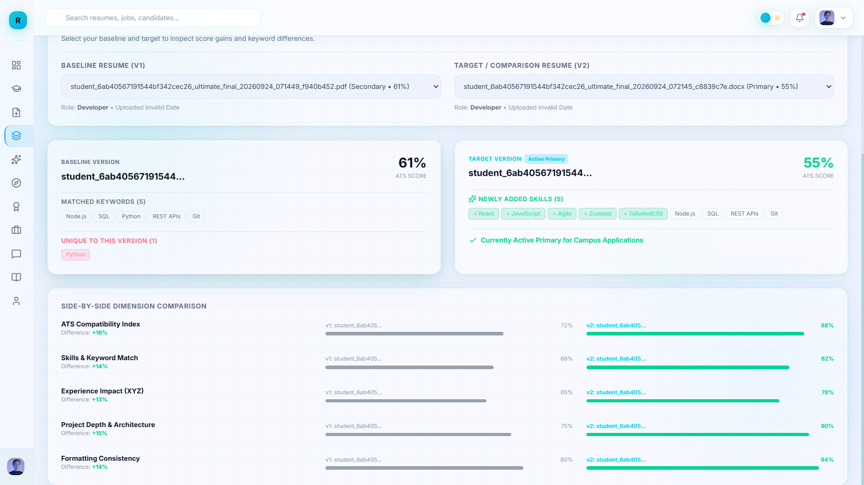
Fig 1.6: Comparision Page

Slide 17
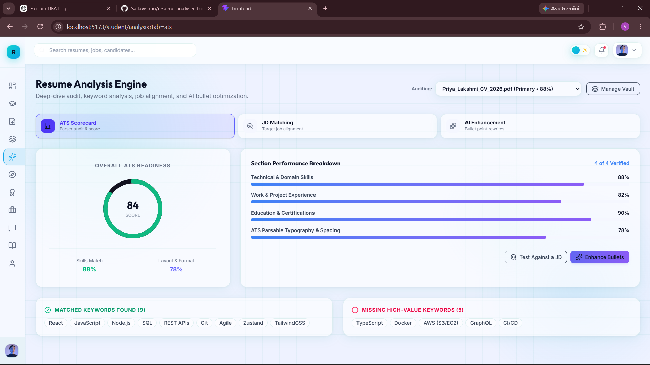
Fig 1.7: Resume Analysis page (ATS check)

Slide 18
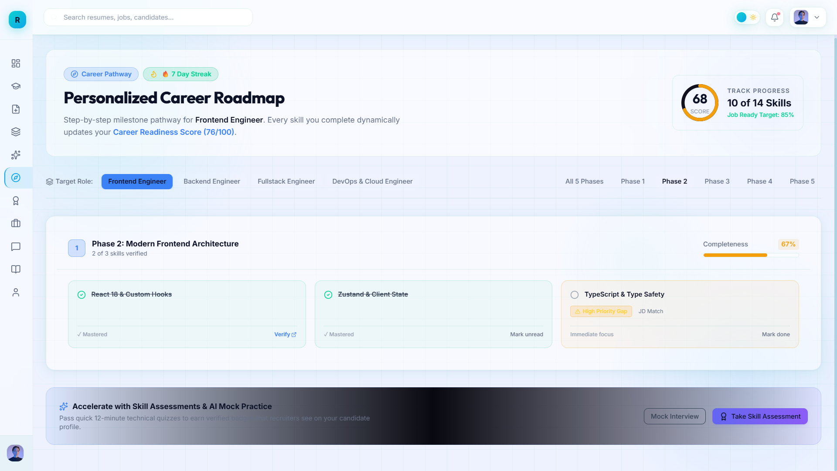
Fig 1.8: Personalized Roadmap

Slide 19
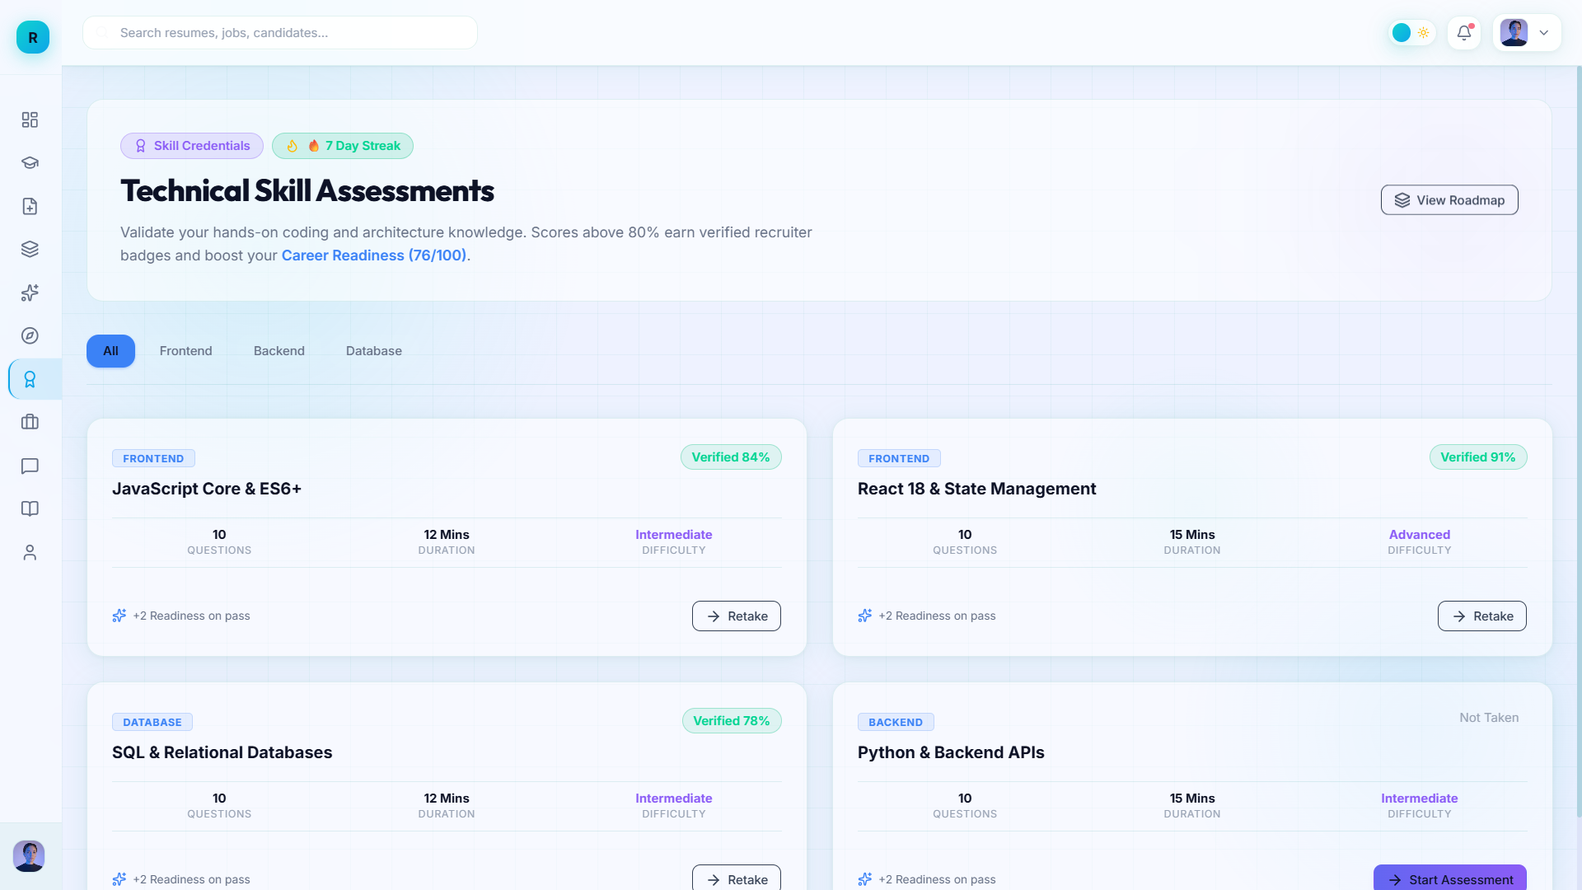
Fig 1.9: Technical Assessments

Slide 20
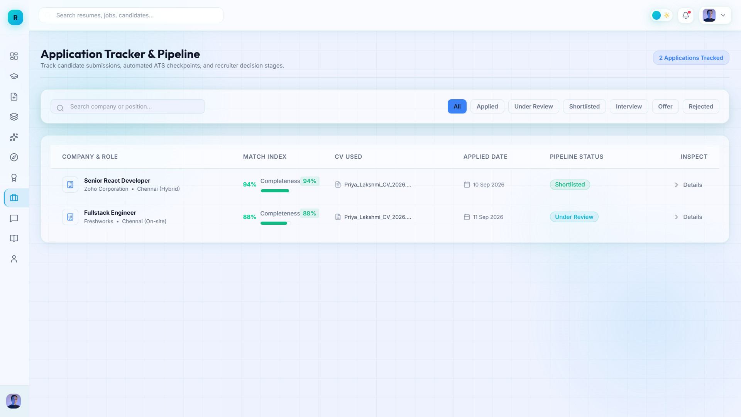
Fig 1.10: Applications Tracker

Slide 21
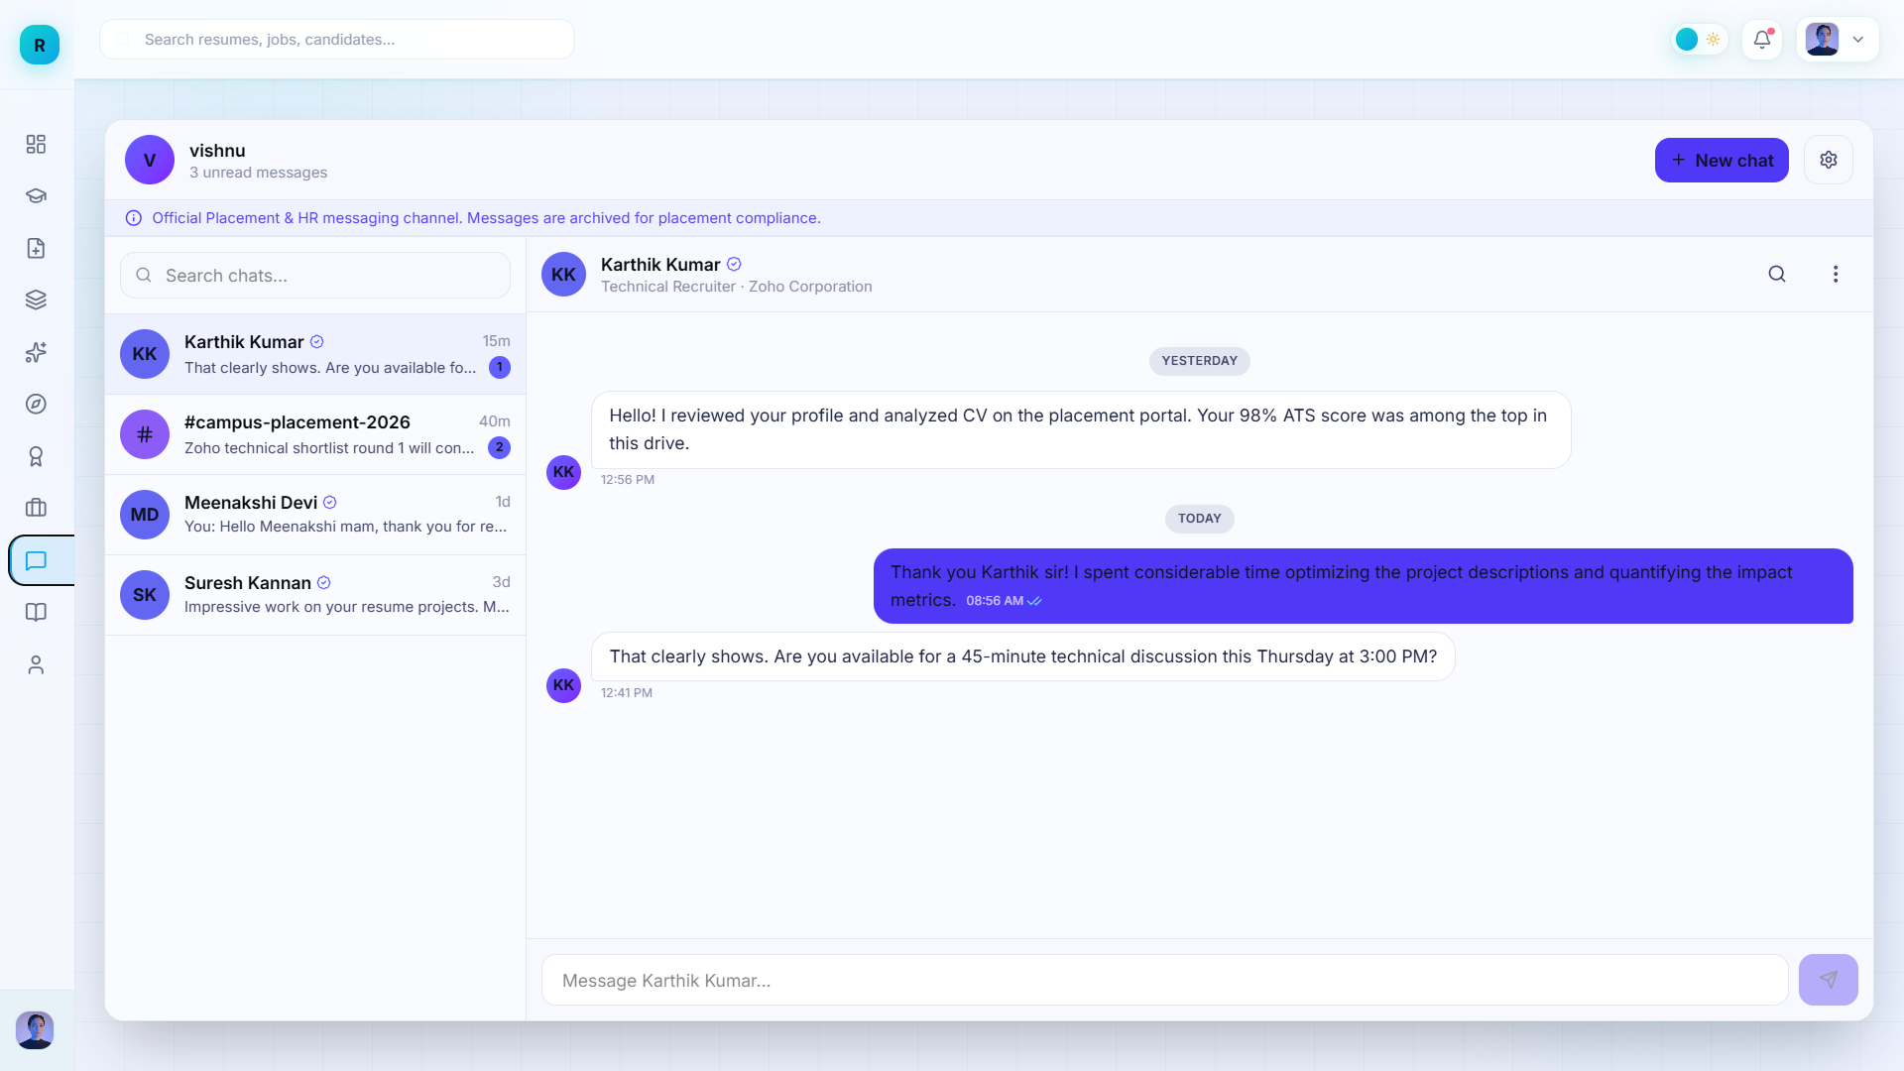
Fig 1.11 : Messaging Page

Slide 22
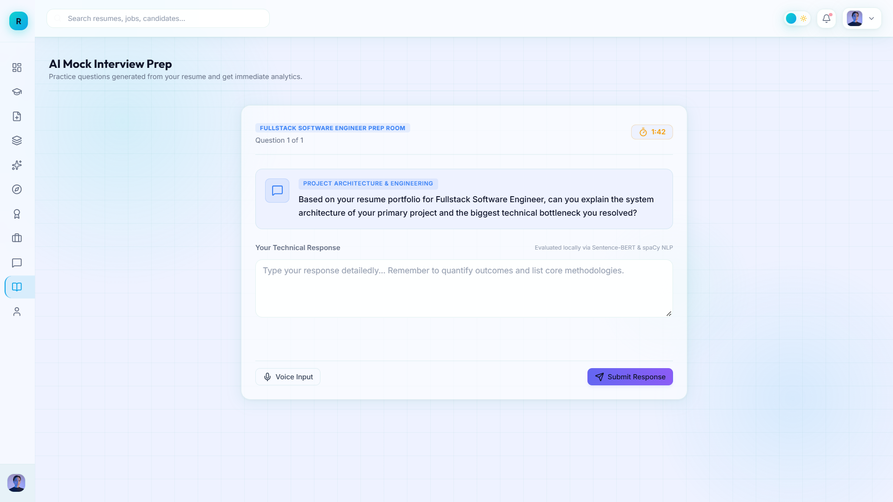
Fig 1.12: AI Interview

Slide 23
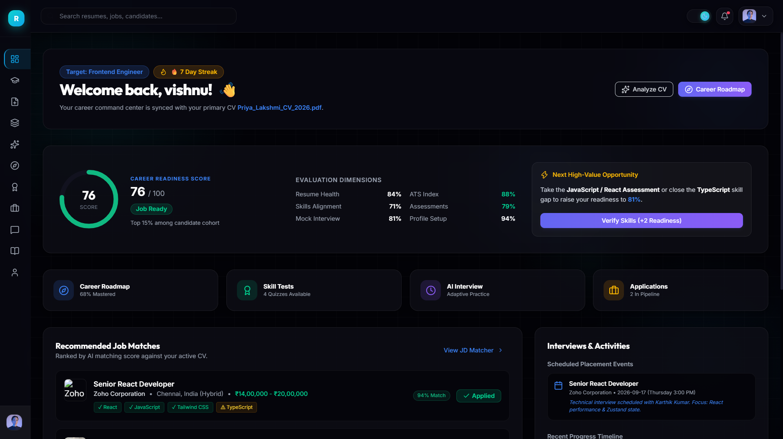
Fig 1.13: Dark Theme ( Dashboard Page)

Slide 24
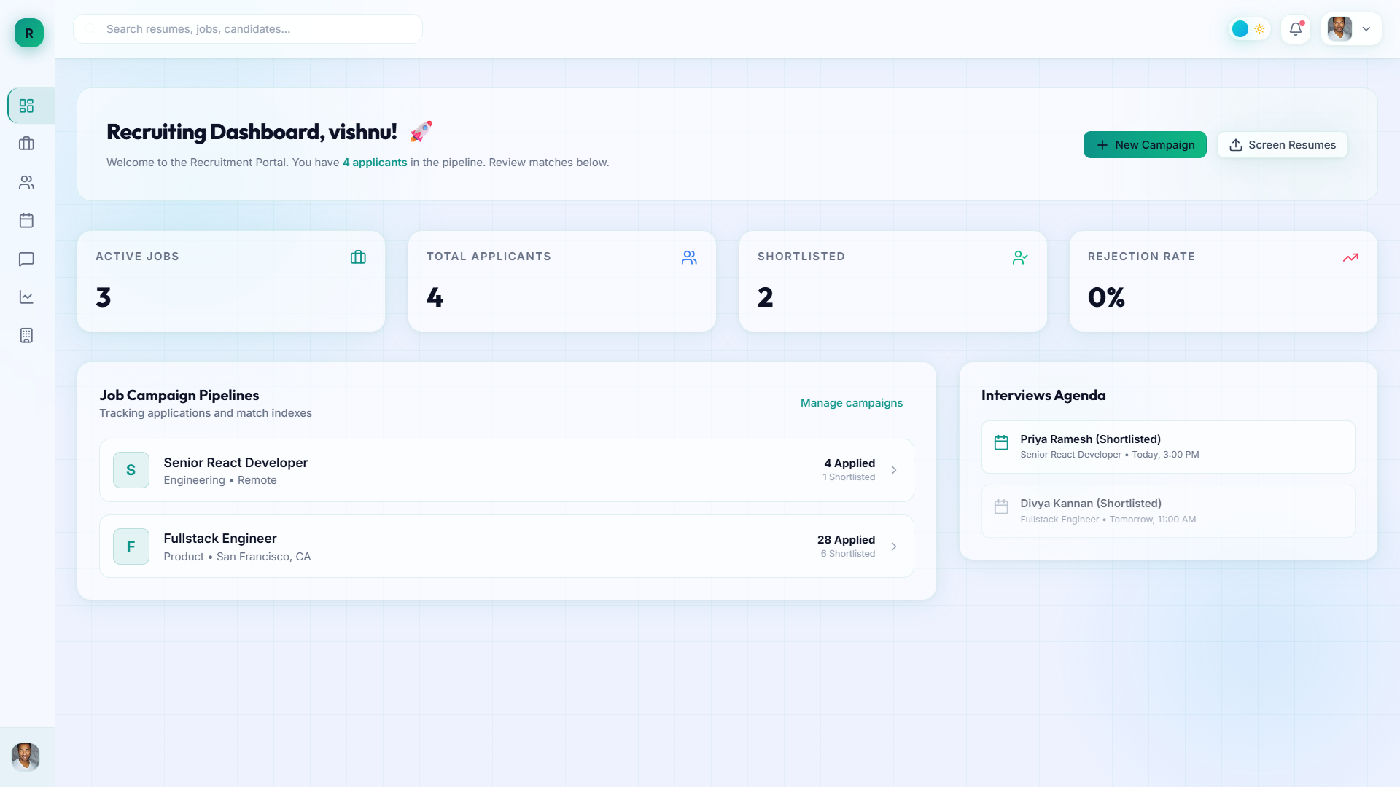
Fig 2.1: HR Dashboard page

Slide 25
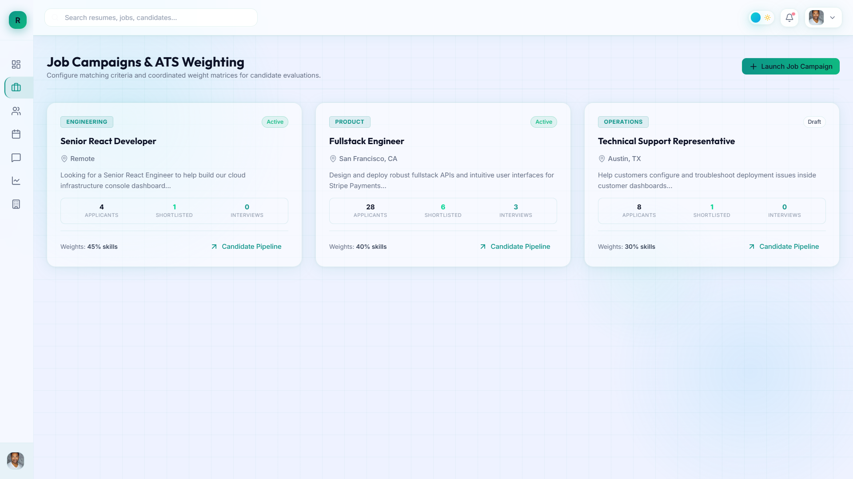
Fig 2.2: Job Posting Page

Slide 26
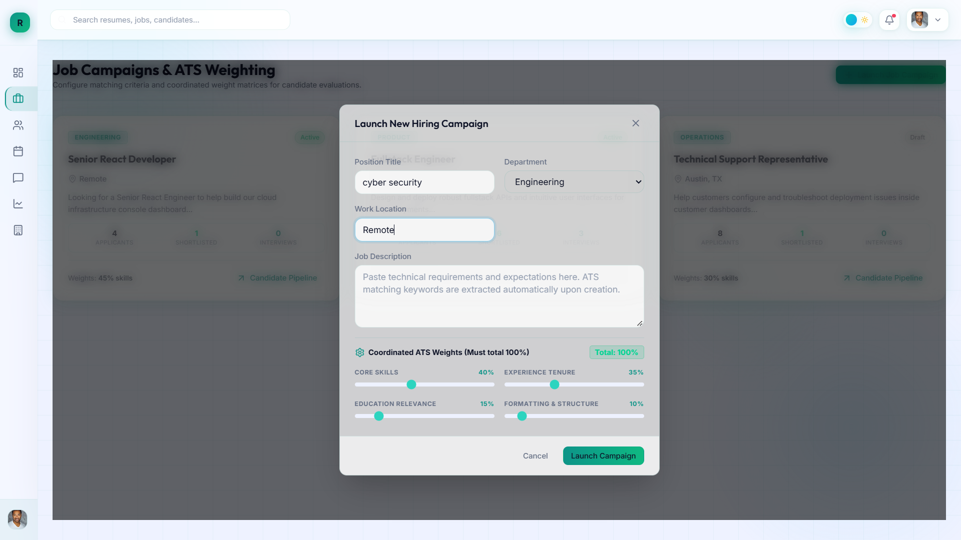
Fig 2.3: New Job Launching Page

Slide 27
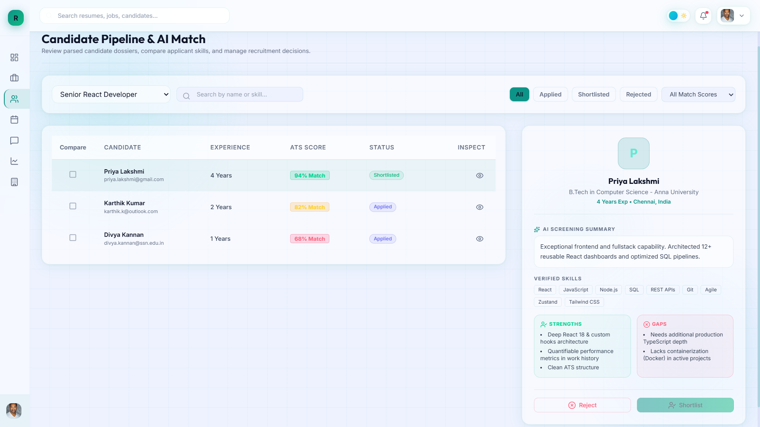
Fig 2.4: Candidate profile page

Slide 28
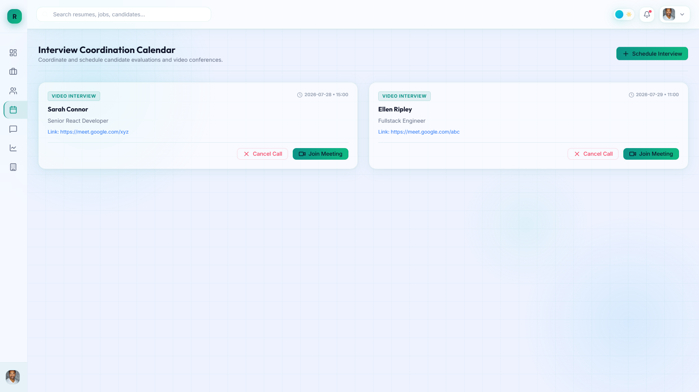
Fig 2.5: Interview With Candidates

Slide 29
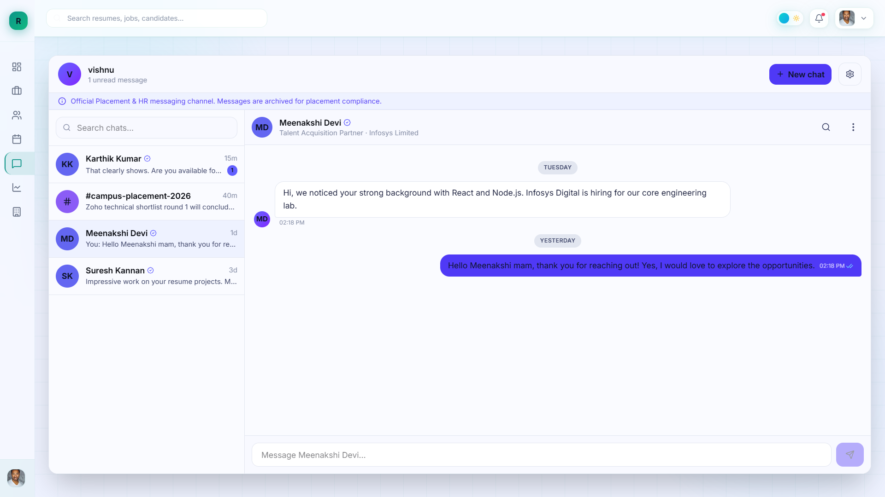
Fig 2.6: Messaging Page (for HR)

Slide 30
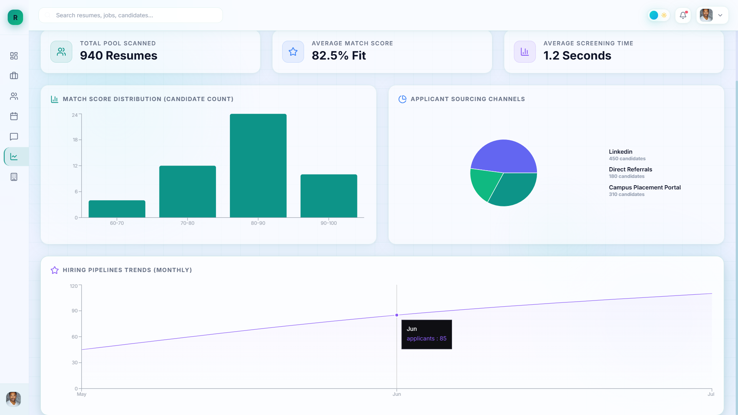
Fig 2.7: Analysis Page

Slide 31
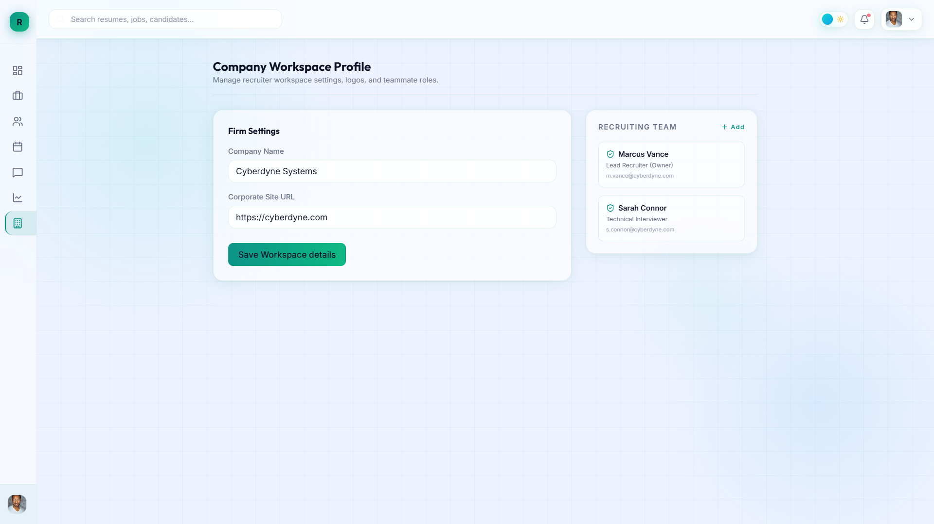
Fig 2.8 : Company Settings Page

Slide 32
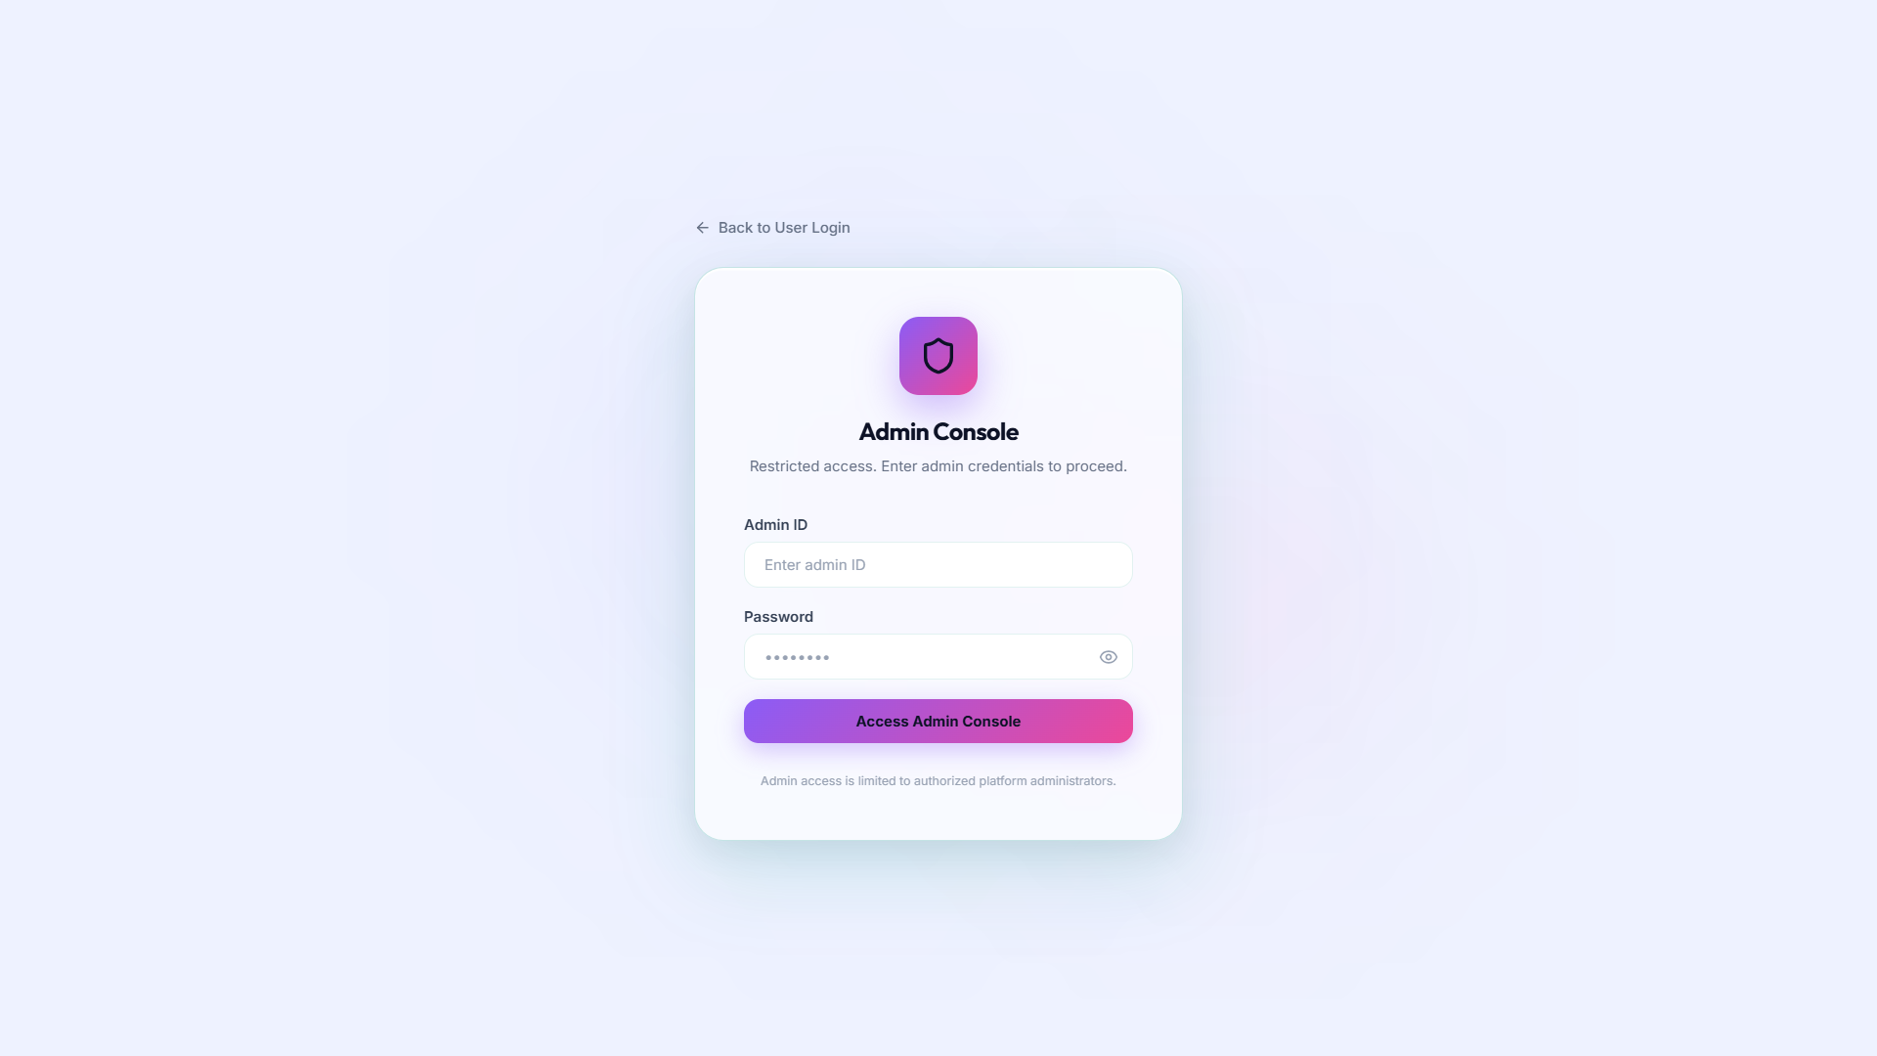
Fig 3.1: Admin Credentials

Slide 33
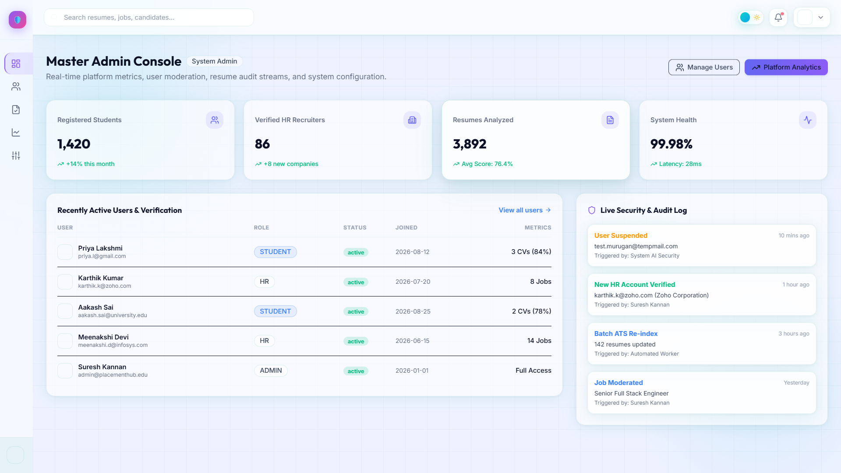
Fig 3.4 : Admin Dashboard

Slide 34
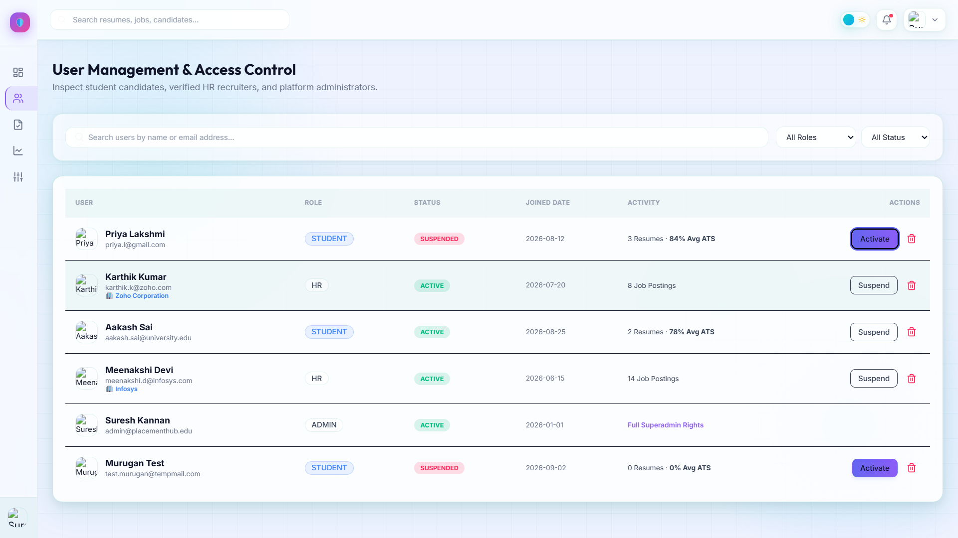
Fig 3.2: User Management page

Slide 35
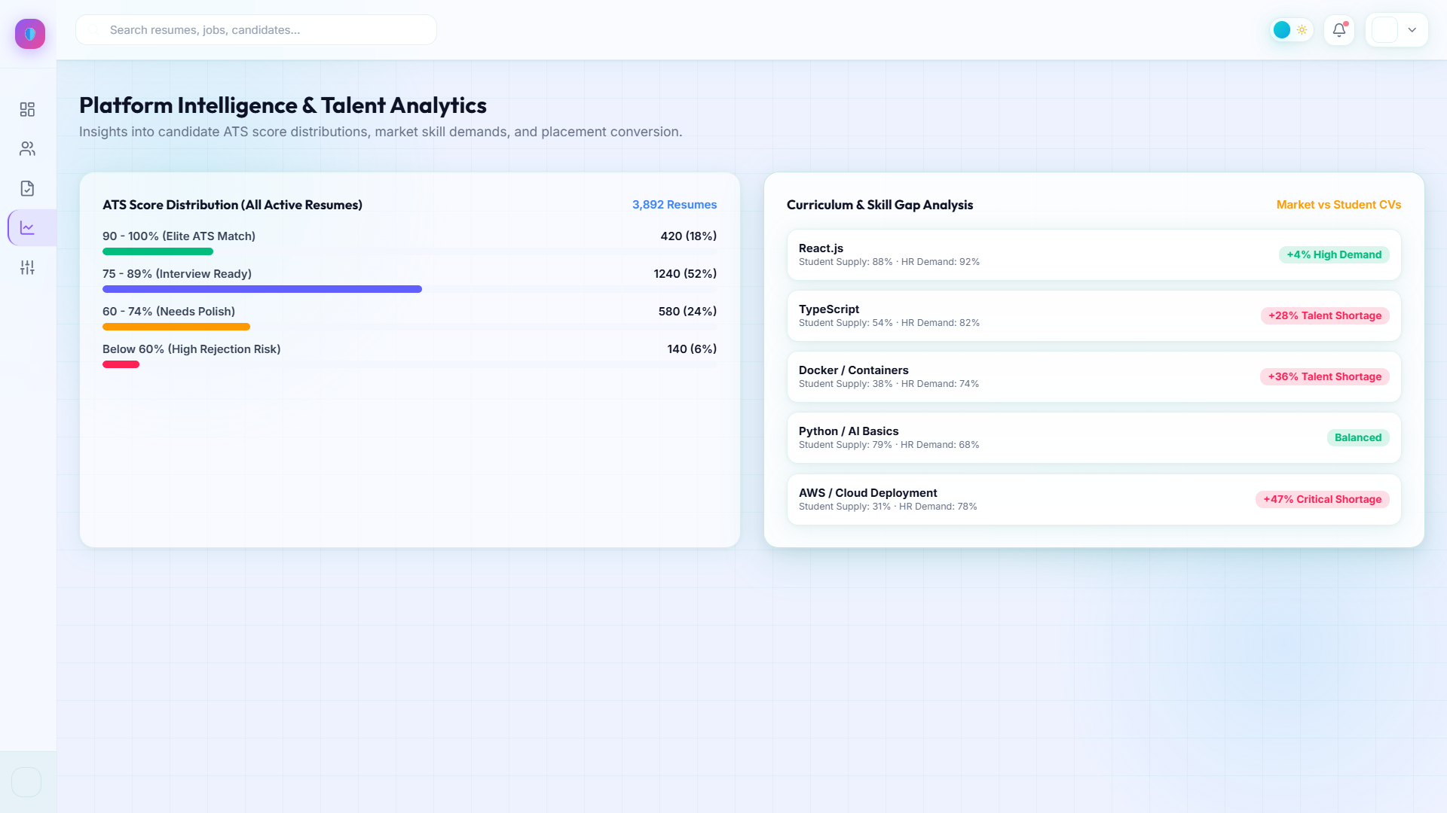
Fig 3.3: Analytics Page

Slide 36
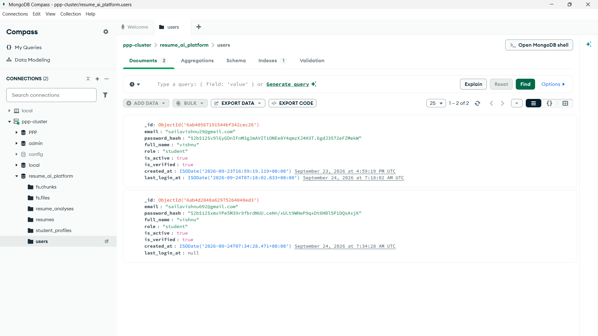
Fig 4.1 : User Collections

Slide 37
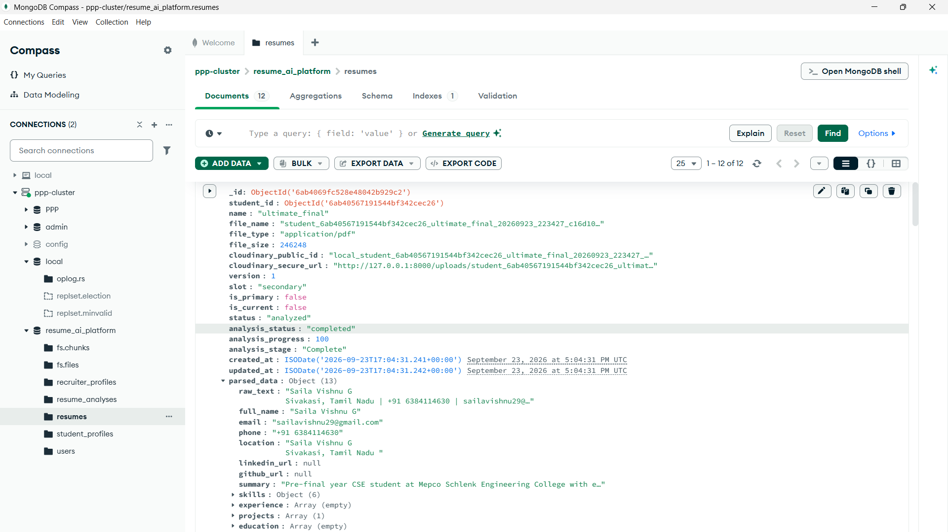
Fig 4.1 : Parsed Resume Collection

Slide 38
Fig 4.1 : Parsed Resume Collection

Slide 39
REFERENCES
Sentence Transformers: Semantic Textual Similarity
https://www.sbert.net/
spaCy: Industrial-Strength NLP
https://spacy.io/
ChromaDB: Vector Database for AI Applications
https://www.trychroma.com/
Google Gemini API Documentation
https://ai.google.dev/
Retrieval-Augmented Generation (RAG) for LLMs
https://www.promptingguide.ai/techniques/rag
Resume Parsing with Machine Learning
https://github.com/pyresparser/resume-parser
FastAPI: Modern Python Web Framework
https://fastapi.tiangolo.com/

Slide 40
Thank You

